Slide 1


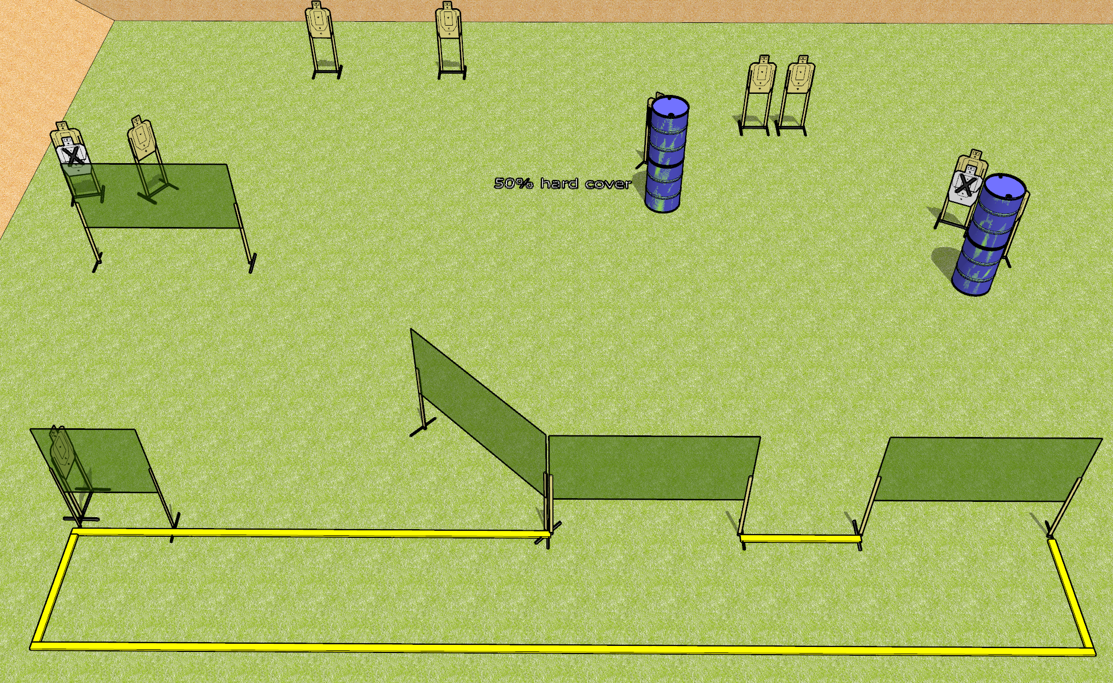
 | Dothan Gun Club – USPSA Match No Name Course Designer : Drew Coleman
Round Count 20 rounds 10 USPSA
Equipment List 10 wall feet 3 medium fault lines 1 50%

Slide 2
No Name
Written Stage Briefing
No Name is a 20 round, 100 point, Comstock course of fire. There are 10 USPSA targets. The best 2 hits on paper will score. The start signal is audible.
Handgun start position is heels touching a forward fault line, wrists below belt. Handgun is loaded and holstered.
PCC start position is heels touching a forward fault line, stock on belt. Loaded carbine is held with both hands, safety on.
On start signal, engage targets as they become available from within the shooting area.

